Slide 1

Overview of Enrollment Procedures

Slide 2
Training Materials for this session
All materials for this session can be found under the Enrollment tab of your training binder
We will be referencing Appendix 1 in your protocol.
  An enlarged version of this can be found in the overview tab (cream color sheet)- this has been updated with LoA#1 and LoA#2.

Slide 3
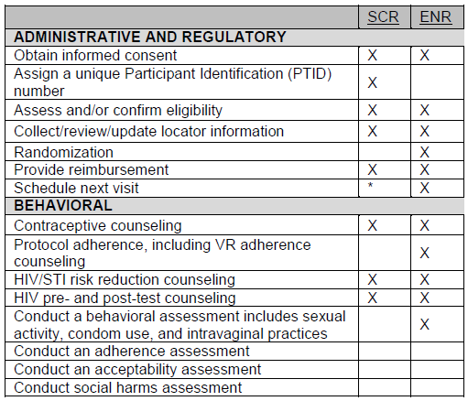
Confirming eligibility and establishing baseline
Admin and Behavioral procedures, per protocol Appendix 1:
Enrollment and off-site IC conducted. Specimen storage is recommended but M1 is allowable. ** This is not a prerequisite for collecting the plasma archive at enrollment
= eligibility
= baseline
Behavioral, clinical and laboratory eligibility criteria. Behavioral eligibility criteria is not listed out explicitly below (captured on the Enrollment Behavioral Eligibility CRF (non-DataFax))
Baseline behavioral assessment (Baseline Behavior Assessment CRF; Enrollment ACASI)
Notes:
First let’s take a look at the administrative/regulatory and behavioral procedures per Appendix 1 that are associated with reassessing eligibility and establishing baseline. If you are unable to see the overhead, turn to appendix 1 in your protocol.
The enrollment visit should be scheduled around the participant’s menses, to ensure it will be an appropriate time for the visit. The only reason not to conduct the visit when on menses is due to the first ring use, and the participant may not be comfortable doing this then. It should be confirmed with the participant that she is not on menses when she arrives to the clinic for her enrollment visit.
[HIT ENTER].
Enrollment IC will take place at the start of the visit (note this difference from VOICE, where the IC was conducted after eligibility was established).
Discuss the IC format specific to the site, specimen storage can be provided at M1 if needed. We do not recommend this as it will require updating of the Enrollment CRF and refaxing at M1 and staff could forget to administer this at month 1.
There is a plasma archive that is collected at Enrollment and this can be conducted EVEN IF the specimen storage IC is not done at enrollment. As a reminder the specimen storage consent allows the site to keep leftover specimens (after per protocol tests have been conducted) for use in future studies. This ICF is not related to the collection of plasma archive in the study.
[HIT ENTER]
‘Assess and/or confirm eligibility’ – this is a catch-all for the behavioral, clinical and laboratory procedures that are conducted during this visit. (read from slide)
As discussed yesterday, adequate locator information is an eligibility criteria and this is confirmed at enrollment, per site SOPs
[HIT ENTER]
In terms of establishing the participant’s baseline, the baseline behavioral assessment will be conducted; this will be reviewed in more detail later this morning.
[HIT ENTER]
So to recap, the procedures with purple stars indicate the eligibility criteria that are addressed in the enrollment visit (IC, confirm eligibility, collecting/updating locator), the green star indicates baseline data collection (behavioral assessment is conducted at enrollment).
3

Slide 4
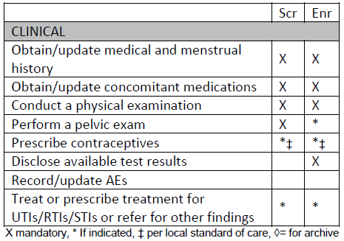
Confirming eligibility and establishing baseline
Clinical procedures, per protocol Appendix 1/ LoA #1:
Medical history is updated on the PRE as needed. Update the Scr Menstrual History CRF with any change in bleeding patterns. Reports at enrollment considered baseline
Abbr. physical exam conducted. Conduct as needed in response to symptoms or exclusionary findings from screening
Conduct if follow-up on an abnormality is needed or symptoms reported. Perform pelvic to provide f/up or address symptom (specimen collection not required if not indicated). Used as baseline if conducted
Notes:
Moving to the clinical procedures per Appendix 1 that are associated with reassessing eligibility and establishing baseline. If you are unable to see the overhead, follow along in appendix 1 in your protocol.
[HIT ENTER].
As discussed yesterday medical/mens history taking will be conducted at screening and documented per the Screening Menstrual History CRF and the Screening Visit Physical Exam CRF. It is not anticipated that menstrual history will need to be updated from the screening visit, but in the event that bleeding patterns have changed, or the participant reports additional information the SMH-1 should be updated and these bleeding patterns used as her baseline. Med/mens history taking is also conducted to confirm eligibility of the participant
Concomitant medications are also updated (assessing concomitant meds should occur during the medical history taking)
[HIT ENTER]
The complete physical exam was conducted at screening; the abbreviated version is conducted at enrollment, as well as follow up to any abnormalities identified at screening that would otherwise be exclusionary
What are the components of the abbreviated physical exam? This is in Section 7 of the protocol (Study Procedures). Section 7.8 is Clinical Evaluations and Procedures. (general appearance, weight, vitals, abdomen)
[HIT ENTER]
Pelvic exam will only be conducted if abnormalities that would be exclusionary were identified at screening. Sites may want to follow up on these abnormalities before the scheduled enrollment visit to ensure they have improved. A new pelvic exam CRF is completed for each pelvic exam (the old one not updated). The most recent pelvic exam conducted prior to randomization is considered the participant baseline and should be faxed to SCHARP if the participant is enrolled. A complete pelvic exam (and specimen collection) is not needed when a follow-up pelvic is conducted- only the procedures necessary for verifying eligibility are required at enrollment.
[HIT ENTER]
Eligibility reassessed: medical history, physical exam, pelvic exam (if indicated)
[HIT ENTER]
Baseline established: medical/menstrual history, physical exam, pelvic exam (if indicated)

Slide 5
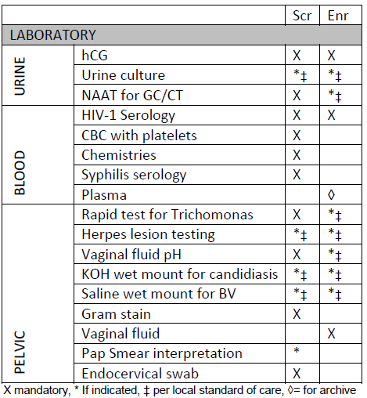
Confirming eligibility and establishing baseline
Laboratory procedures, per protocol Appendix 1, LoA #1 and LoA #2:
If blood tests meet exclusionary criteria at the Screening visit and warrant retesting they should be retested prior to Enrollment to allow TAT.
Baseline plasma collection is critical in order to confirm eligibility into the trial for seroconverting participants
Self-collected vaginal swab (= ‘vaginal fluid’ per protocol).
Notes:
Finally, let’s look at the eligibility reassessments for laboratory, as well as what baselines are established
[HIT ENTER].
Purple stars indicate the procedures done to confirm eligibility and green stars indicate baseline measures.
Testing for pregnancy and HIV are conducted again at Enrollment. Other urine tests are done if indicated (based on symptoms, or any follow-up from the previous visit that is needed).
As discussed the pelvic exam is only collected at screening and only conducted if indicated at enrollment. The pelvic specimens will ONLY be collected at enrollment if needed to follow up on the abnormality, or if indicated based on symptoms expressed at enrollment.
Plasma is collected for archive- as mentioned earlier this baseline plasma sample will be used to confirm eligibility in the event she seroconverts during the study.
Vaginal fluid (self-collected vaginal swab)

Slide 6
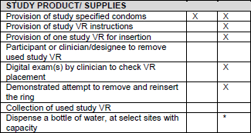
Confirming eligibility and establishing baseline
Study product/supplies per protocol Appendix 1:
Scr Enr
Notes:
The finish up the review of procedures per the protocol appendix 1- the study product/supplies section is shown here. There will be a separate presentation later today that talks about this section in more detail.
In brief- after randomization, the ring is provided, the product use instructions and education is provided; first ring use and digit check conducted. Condoms are provided (if not already) and water is provided if needed at your site.

Slide 7
How is the enrollment visit different?
Confirm eligibility
Document baseline conditions
Randomize when the above is conducted and confirmed
  Randomization is the act of enrollment for ASPIRE
  Enrollment visits cannot be split
Notes:
Why is it important for randomization to come at the end of the visit?
Can’t randomize until we’ve confirmed she’s eligible and baseline is assessed. Goal of baseline is to collect this data before she has contact with study product.
Once she is randomized, she is a participant in the trial and should be followed through the trial until trial completion (unless she decides to withdraw from the study).
The only parts of the visit that should happen after randomization are procedures involving the study product:
Provision of study VR instructions
Provision of VR for insertion
Digit exam
Demonstrated attempt to remove and reinsert the ring
Ring education/adherence counseling
[more on this section next]
For this reason the enrollment visit CANNOT be split.
So what would happen if the visit cannot be completed in one day?

Slide 8
Participant HAS NOT been randomized:
Reschedule the participant for the enrollment visit (keeping in mind 28 day window)
ALL procedures repeated except administration of the informed consent(s)
No CRFs from an incomplete enrollment visit should be faxed to SCHARP (but they should be maintained in the participant file)

Slide 9
Participant HAS been randomized:
The visit is considered her enrollment visit even if all procedures were not conducted
If the participant did not receive the study product she should be scheduled to come in as soon as possible- to get the study product, first product use/ digit exam/ debrief, and first ring use education session conducted
Notes:
Randomization is the act of enrollment- if this has taken place, she has been enrolled.
Bullet 2: when she comes to receive study product all procedures following this should be conducted (first ring use education, first insertion and debrief, digit exam etc). An interim visit month would be used in this instance: visit codes for this will be discussed in more detail tomorrow

Slide 10
What if plasma archive is missed?
This is necessary to confirm eligibility as needed later in the trial and should always be collected prior to randomization (before contact with study product).
She should be scheduled to come in as soon as possible for the collection of this
Notes:
Plasma archive is the only procedures performed at enrollment that, if missed, should be made up as soon as possible.
** No other procedures are made up if missed at enrollment

Slide 11
Order of visit procedures at enrollment is important
What are the key procedures of the enrollment visit that must be conducted in the correct order?
  Enrollment IC
  Eligibility confirmation
  Behavior assessments (CRF, ACASI), blood collection for plasma archive, self-collected swab (per LoA#2)
  Randomization
  Study product provision/related procedures
Notes:
Group to respond to this question

Slide 12

Enrollment Visit
CRF documentation

Slide 13
Enrollment (ENR-1)
Captures dates of screening and enrollment IC
Item 3: Mark ‘pending’ box and update later if post-study storage consent not presented at EV; change response as needed if ppt changes her mind
HIV/pregnancy items used to document in the database the ppt’s eligibility
Randomization info is transcribed from Randomization/ Prescription Tracking Record for Clinic
Items 9-12: if not done on same day as randomization (item 7), mark ‘no’ (items are considered missed)
  Note: Of 9-12, only plasma archive specimen needs
  to be made up if not done on day of randomization
Notes:
The Enrollment CRF captures the dates of the Screening and Enrollment Informed Consent as a way for SCHARP to double-check that the participant was enrolled within the screening window of 28 days.
If storage consent is not provided to the participant at the Enrollment Visit, you may mark the pending box and update as needed during the study if the participant changes her mind.
The HIV and pregnancy related items on this form as used to double-check that the participant is eligible as these results are not collected and captured on any other CRF.
The Randomization information will be transcribed from the Randomization and Prescription Tracking Record.
Items 9 through 12, which document Baseline ACASI questionnaire completion, plasma archival, participant self-collected vaginal fluid swab collection and vaginal ring insertion are all required at the Enrollment Visit. Because the Enrollment Visit cannot be split, if these procedures are not completed on the same day as Randomization (item 7), they must be marked ‘no’

Slide 14
Prior Trial Participation (PTP-1)
Collects info on whether the participant was enrolled in
  VOICE
  other microbicide trials
  PrEP trials
  any other research studies
Collects how the participant heard about ASPIRE
VOICE participation must be confirmed with a PTID; other items are per ppt self report
Will provide information on how ‘active’ ASPIRE ppts are in research trials overall and across sites
Notes:
The Prior Trial Participation CRF will collect information on whether participants have enrolled in VOICE, PrEP trials, other microbicide trials, or other research studies. Participants will also be asked how they heard about ASPIRE.
If a participant indicates that she has participated in VOICE, this must be confirmed with a PTID (item 1a)
This form will provide interesting information on how ‘active’ participants in ASPIRE are in clinical research studies in general and it will be interesting to look at across sites.

Slide 15
Enrollment Behavioral Eligibility
Non-DataFax
One page, used to confirm behavioral eligibility criteria at EV
Interviewer administered, translated, read aloud word-for-word
Complete all items
Provide clarity as needed
Complete all items, regardless of ppt’s responses

Slide 16
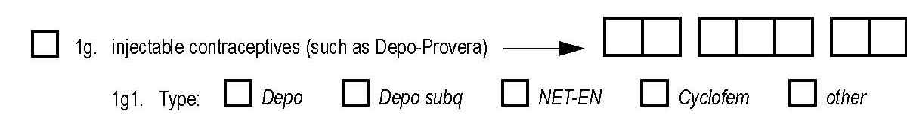
Baseline Family Planning (BFP-1)
Complete based on ppt self-report
Mark all methods the participant is currently using; do not include methods she is planning to use’
Items 1e-1i: Record date the ppt started using that particular method
  record on Con Meds Log also; dates of use may differ
Item 1g1 – mark specific type of injectable used
Notes:
The Baseline Family Planning CRF is based on participant self-report and is not interviewer-administered and is not translated.
Mark all methods that the participant is currently using and do not include any methods that the participant is planning to use.
For items 1e-1i, record the date that the participant starting using that particular method. For example, if a participant reports that she started using Depo in October 2010, mark 1g and write October, 2010 for the date regimen started (line through day and mark UNK). Records any hormonal methods used on the Concomitant Medications Log as well using the trade name of the contraceptive if possible.
Items 2 and 3 ask for the participant’s first and last day of her last menstrual cycle. Record these dates as of the Enrollment Visit and do not go back and update these items at month 1 even if the participant’s last menstrual cycle is ongoing at Enrollment. The purpose of these dates is to collect whether the participant is currently menstruating at the time of the visit).
Baseline pregnancy data in Items 4 and 4a are participant self-reported

Slide 17
Baseline Family Planning (BFP-1) – con’t
Items 2, 3: Record dates (or amenorrheic for past 6 months) as of the EV. Purpose is status of menses at time of visit.
    If item 3 is ongoing, do not go back and update at Month 1
    Items 2 and/or 3 may duplicate information captured at the SV on the SMH form – that is fine
Item 4: based on ppt self-report (medical records not needed)
Notes:
Items 2 and 3 ask for the participant’s first and last day of her last menstrual cycle. Record these dates as of the Enrollment Visit and do not go back and update these items at month 1 even if the participant’s last menstrual cycle is ongoing at Enrollment. The purpose of these dates is to collect whether the participant is currently menstruating at the time of the visit).
Baseline pregnancy data in Items 4 and 4a are participant self-reported

Slide 18
Enrollment Abbreviated Physical Exam (EPX-1)
Items 1-7 are required to be assessed
  Vitals, general appearance, abdomen/gastrointestinal
All items require a response
  Mark ‘not done’ for Items 8-17 if not assessed
Update PRE as needed
  Add new conditions as needed
  Complete “Ongoing at Enrollment” for any previously-recorded conditions as needed

Slide 19
Eligibility Criteria (ECI-1)
Allows SCHARP to report on
  # screened
  # enrolled
  # screen fails
  reasons for screen failures
Complete and fax for all participants who start an EV, even if they do not enroll (only form faxed if not enrolled)
If a participant screen fails, then screens again
  Always update and re-fax original ECI completed for the participant - do not complete a 2nd (new) ECI CRF

Slide 20
Baseline Behavior Assessment (BBA)
Interviewer-administered, translated, read aloud word-for-word
Complete all items; provide clarity as needed
Page 1 collects info on primary sex partner: his HIV status, use of ARVs, circumcision status, study/ring disclosure status, clinic attendance
  Item 7 (partner’s ARV use) is asked regardless of whether partner HIV status is known (per item 6)

Slide 21
Baseline Behavioral Assessment – con’t
BBA PAGE 2
Other sex partners, frequency of vaginal sex (past 3 months, 7 days), anal sex, condom use
BBA PAGE 3
Ppt’s worries about the ring
Item 17: If ppt is ‘very worried’ about using a ring for at least one year, site may want to re-consider whether to enroll her or not
Item 18: each specific ring use worry requires a yes/no response. This item will be asked again at
Month 3 and PUEV/early termination

Slide 22
Baseline Vaginal Practices (BVP-1)
Interviewer-administered, one page
Captures use of products that may alter vaginal/intravaginal environment
Collects info on vaginal items used during menses and in general
These same questions will be asked every 6 months and at PUEV/early termination

Slide 23
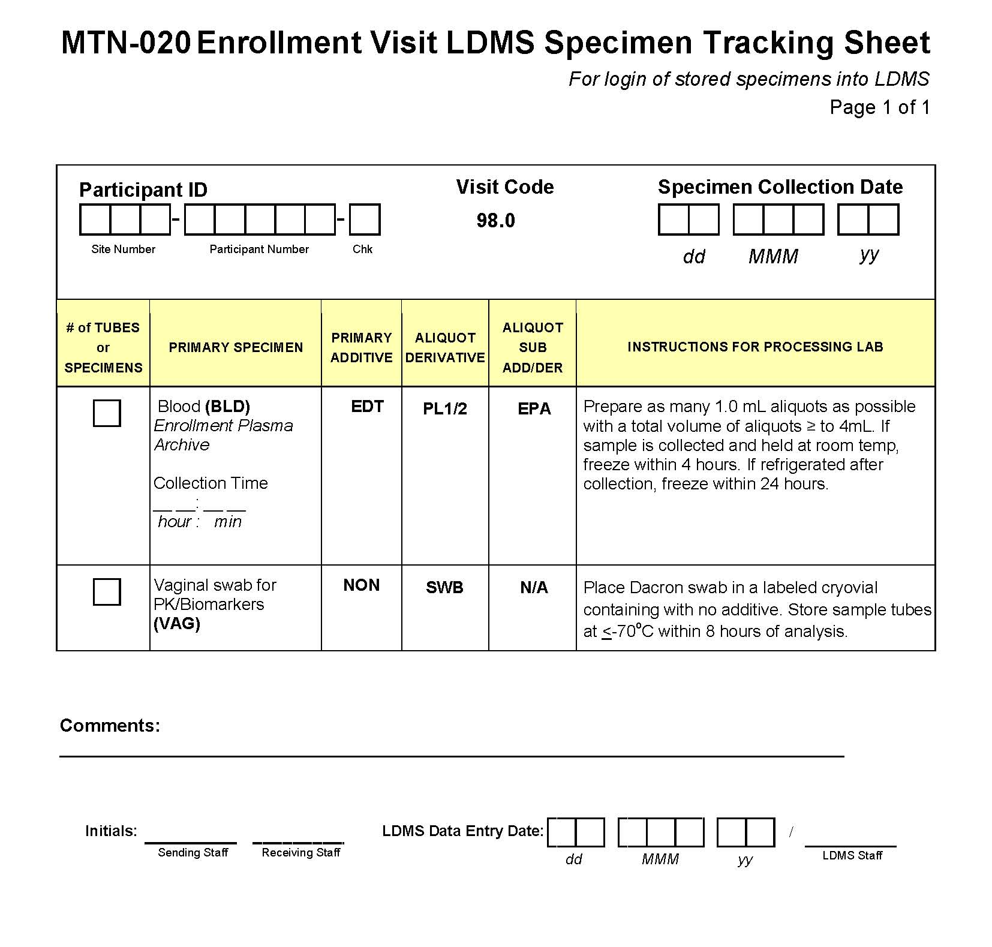
Enrollment Visit LDMS Tracking Sheet
Optional form
Collection of specimens captured on ENR CRF (items 10, 11)
Visit Code has been pre-printed
= 98.0
Notes:
This form will be discussed during the lab section. The only thing to note is that the Visit Code is already present and hard-coded to Visit 98.0 and that two specimens will be required for storage at the Enrollment Visit – blood for plasma archive and the participant self-collected vaginal swab.

Slide 24
Enrollment Visit QA/QC
During visit:
  Review the 3 interviewer-administered CRFs to ensure completeness and skip patterns followed
  Make sure eligibility is confirmed per SOP prior to randomization
  Review visit checklist to make sure all required procedures completed, including plasma archive collection
If Randomized/Enrolled
  Fax all appropriate SV and EV forms to SCHARP
  Fax appropriate lab results/pelvic exam CRFs I n cases where repeat results are available

Slide 25
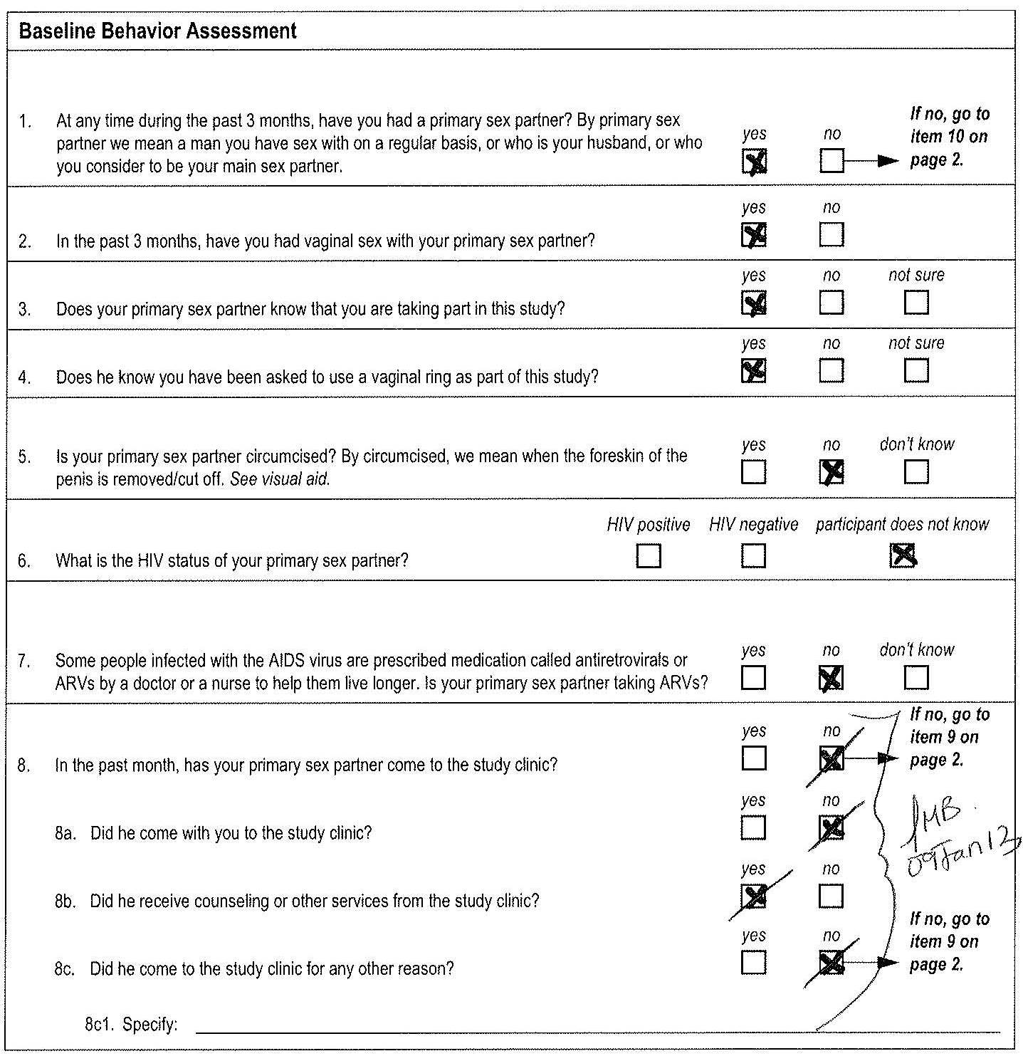
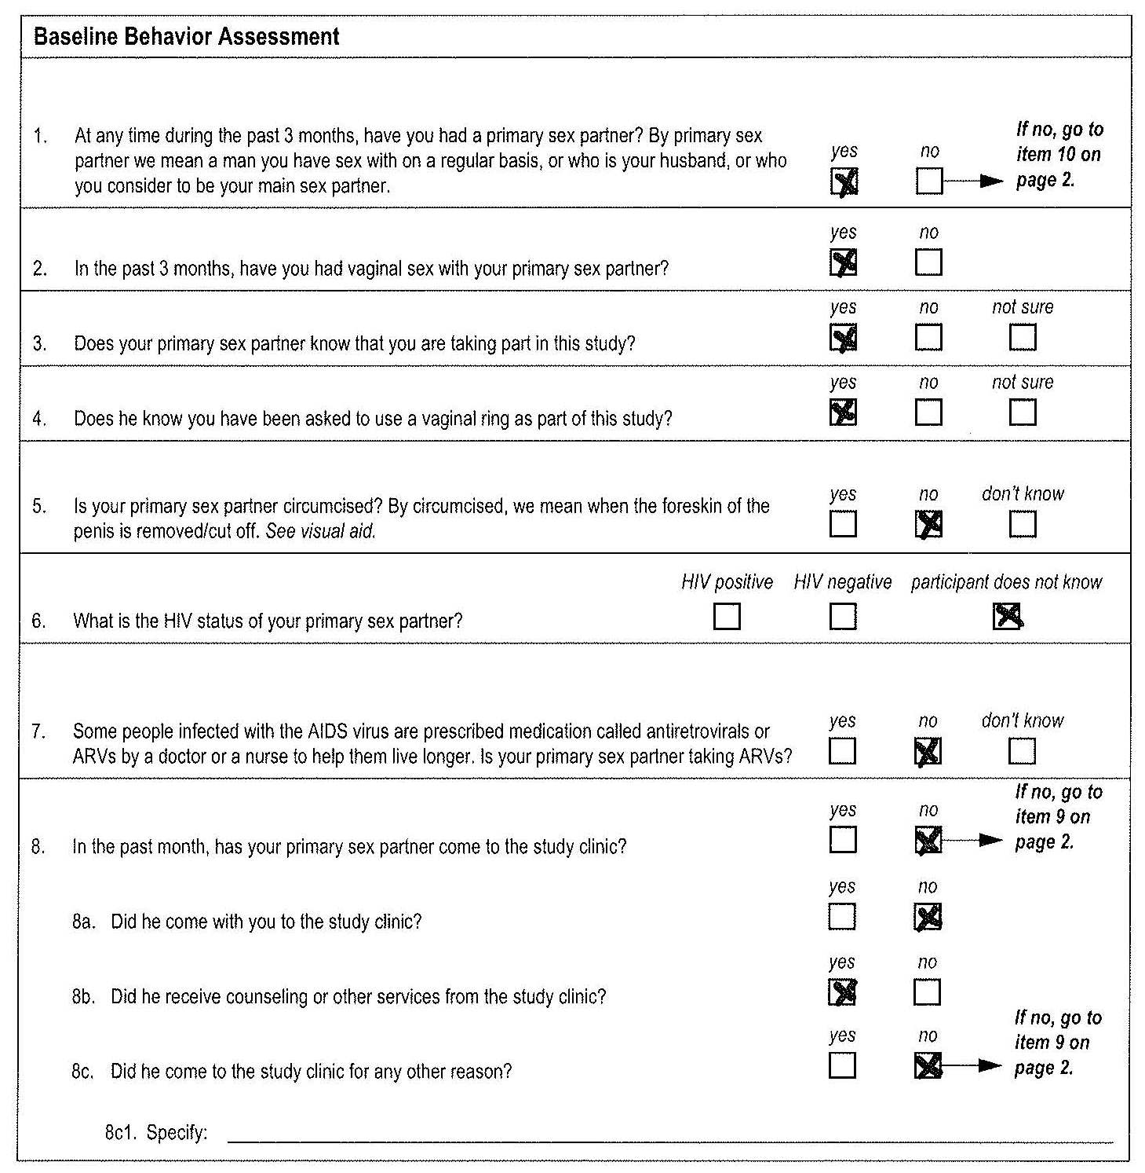
Resolving QCs on Interviewer Administered CRFs
If item is marked and it should not have been completed:
Line through the marked box, initial date and refax
[In this example, can use brackets for 8a through 8c]

Slide 26
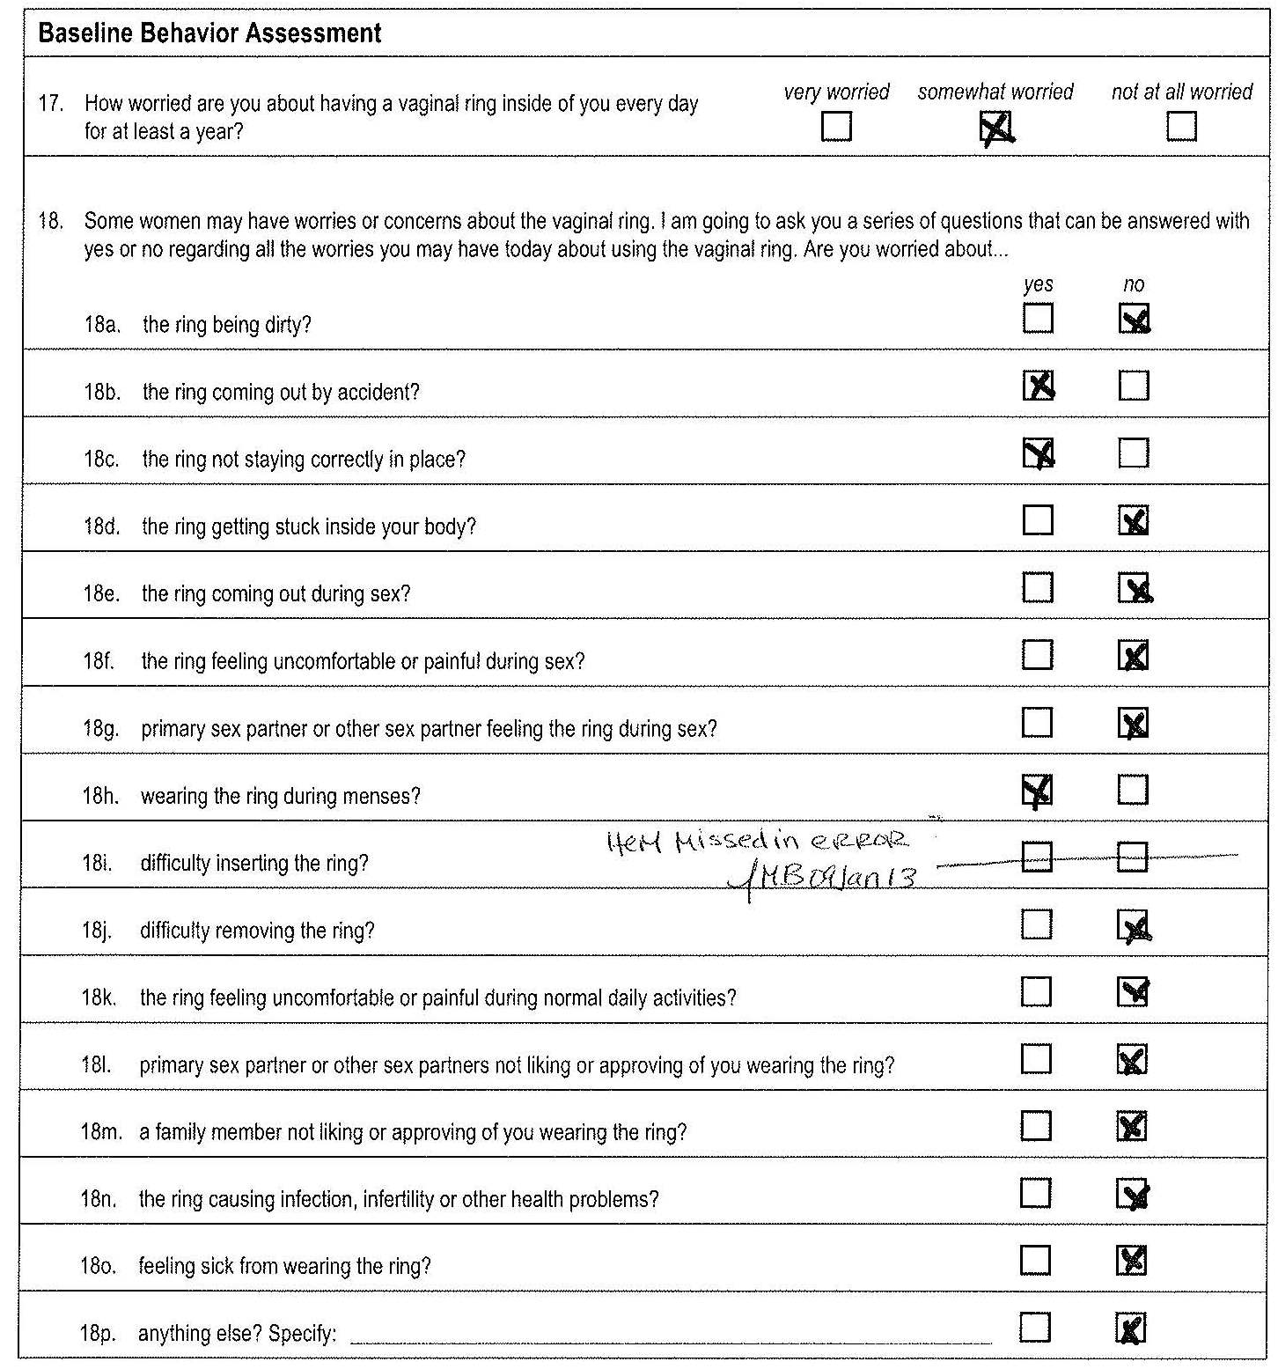
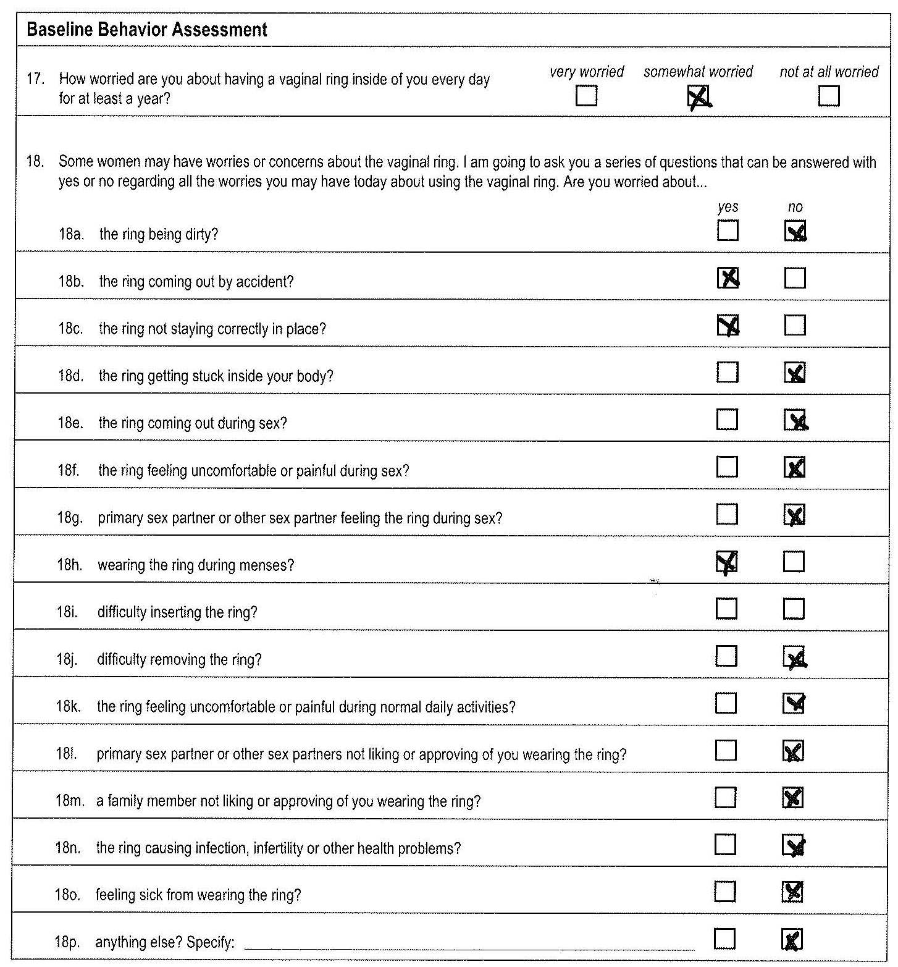
Resolving QCs on Interviewer Administered CRFs
If item is not marked and it should have been completed:
Line through the item boxes, initial date and refax
Use white space next to item to explain ‘item was missed in error’

Slide 27
Screening/Enrollment/ Eligibility Scenarios

Slide 28
Scenario Instructions
Will get into groups for small group discussion
Handout of all scenarios - please talk through all of the scenarios and questions included for each scenario
Review answers as you go with group leader/Training Team Rep
Will discuss questions as a group at end

Slide 29
References
Protocol Section 7.3 (Enrollment)
Protocol Appendix 1
SSP:
  Section 4.4 (Enrollment Procedures)
  Section 10.1 (Baseline Medical Conditions)
  Section 14 (Data Collection)

